Slide 1

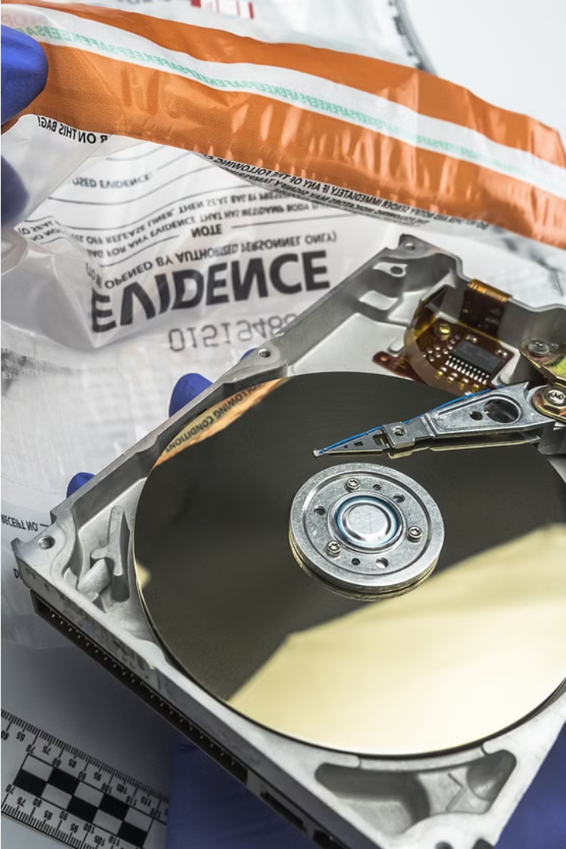

Fundamentals of Digital Evidence
Computer forensics is the practice of collecting, analyzing, and preserving digital evidence to aid in the investigation of crimes and other legal matters. It involves the systematic examination of computer systems and digital data to uncover crucial information.

Slide 2
Fundamentals of Digital Evidence
1
Identifying Digital Evidence
2
Preserving Digital Evidence
Digital evidence includes any data stored or transmitted using digital technologies, such as emails, files, and network logs, that can be used to investigate a crime or other incident.
Proper handling and preservation of digital evidence is crucial to ensure its admissibility in legal proceedings. This includes documenting the chain of custody and using forensically sound techniques to acquire and store the data.
3
Analyzing Digital Evidence
4
Presenting Digital Evidence
Digital forensic analysts use specialized tools and techniques to extract, analyze, and interpret digital evidence, uncovering important information related to the case or incident.
Effectively communicating the significance and implications of digital evidence is crucial in court or during investigations. Forensic experts must be able to explain complex technical details in a clear and compelling manner.

Slide 3




Data Acquisition and Preservation
Forensic Imaging
Create a complete, bit-for-bit copy of digital media to preserve evidence in its original state without altering the original data.
Chain of Custody
Maintain strict documentation of the location, handling, and possession of digital evidence to ensure its admissibility in legal proceedings.
Secure Storage
Store digital evidence in a controlled environment to protect it from tampering, degradation, or loss, ensuring its integrity over time.

Slide 4
File System Analysis
File Allocation
Metadata Examination
Analyzing the way files are organized and stored on a storage device is crucial in computer forensics. This provides insights into how data was accessed and modified.
Forensic experts scrutinize file metadata, such as creation, modification, and access timestamps, to reconstruct the timeline of events and user activity.
Unallocated Space
File System Structures
Investigating the unallocated or "free" space on a storage device can reveal deleted files, fragments, and other relevant evidence that may have been overlooked.
Understanding the underlying file system structures, such as directories, indexes, and journal logs, helps forensic analysts piece together a comprehensive picture of the digital evidence.

Slide 5
Data Recovery Techniques
Data Extraction
1
Retrieving data from damaged or deleted files
File Carving
2
Reconstructing fragmented data from disk sectors
Data Decryption
3
Unlocking encrypted data through cryptanalysis
Data recovery is a critical aspect of computer forensics, enabling investigators to extract valuable evidence from damaged, deleted, or encrypted digital sources. Techniques like data extraction, file carving, and data decryption are essential for piecing together the digital trail and uncovering crucial information hidden within the data.

Slide 6

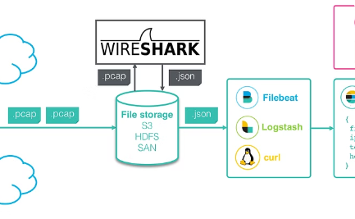
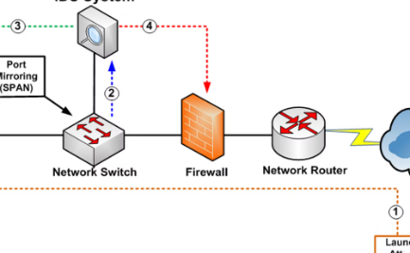
Network Forensics
Traffic Monitoring
Packet Inspection
Intrusion Detection
Network forensics involves capturing and analyzing network traffic data to detect and investigate cyber incidents, such as data breaches, unauthorized access attempts, and malware infections.
Forensic analysts examine network packets, protocols, and metadata to reconstruct communication patterns, identify suspicious activities, and gather evidence for incident response and legal proceedings.
Network forensics leverages intrusion detection systems (IDS) and firewalls to identify and investigate unauthorized access, data exfiltration, and other malicious network activities in real-time.

Slide 7



Mobile Forensics
Device Acquisition
Data Extraction
Encryption Challenges
Properly acquiring and preserving mobile devices is crucial in mobile forensics. Techniques like Faraday bags and write-blockers help ensure data integrity.
Extracting data from mobile devices, including contacts, messages, location history, and app data, provides critical evidence for investigations.
Mobile device encryption poses unique challenges, requiring specialized tools and techniques to bypass security measures and access protected data.

Slide 8
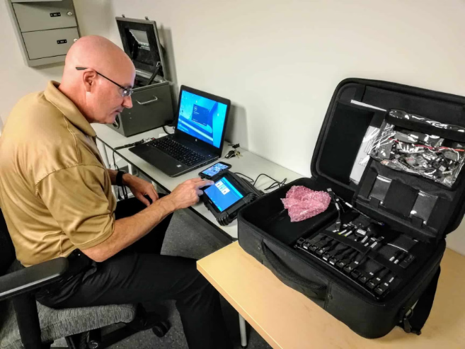
Forensic Tools and Techniques
Computer forensics relies on a range of specialized software and hardware tools to acquire, examine, and analyze digital evidence. These tools are designed to preserve the integrity of data, recover deleted or hidden files, and uncover patterns of user activity.
Forensic examiners employ techniques such as file system analysis, data carving, and network traffic monitoring to extract valuable insights from complex digital artifacts. These methods require deep technical expertise and meticulous attention to detail.

Slide 9
Legal and Ethical Considerations
Legal Frameworks
Ethical Principles
Chain of Custody
Expert Testimony
Computer forensics is governed by various legal frameworks, such as rules of evidence and digital privacy laws, which must be strictly adhered to ensure admissibility of evidence in legal proceedings.
Forensic practitioners must uphold ethical principles, including respect for privacy, confidentiality, and integrity of data, to maintain public trust and avoid misuse of their specialized knowledge.
Maintaining a robust chain of custody is crucial in computer forensics, as it ensures the authenticity and reliability of digital evidence throughout the investigative process.
Forensic examiners may be required to provide expert testimony in court, necessitating comprehensive knowledge of procedures, tools, and the ability to effectively communicate technical findings to non-technical audiences.

Slide 10

Conclusion and Future Trends
As we've explored the fundamental principles of computer forensics, it's clear that this field will continue to evolve alongside the rapid advancements in technology. In the years ahead, we can expect to see further developments in data recovery techniques, mobile forensics, and the application of artificial intelligence and machine learning to streamline investigative processes.

